Slide 1
SkillCourt 6.0
Fall 2016; This semester’s…
Shortcomings and Wish-list

Slide 2
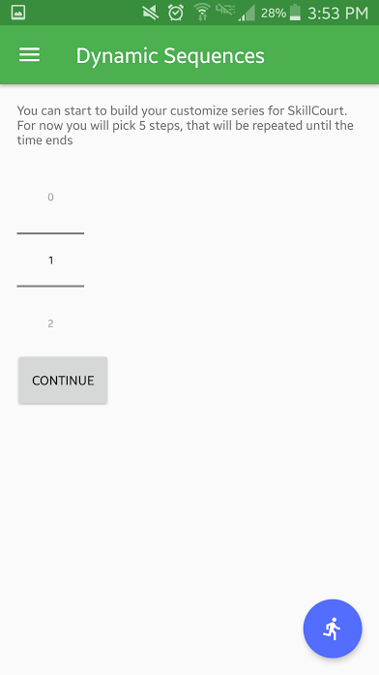
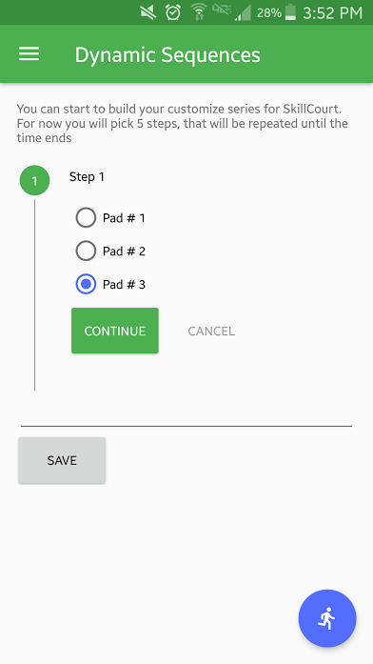
Shortcomings
Things we planned to do, but did not have time to complete
As a coach, assign sequence to team
As a coach, assign sequence to player

Slide 3
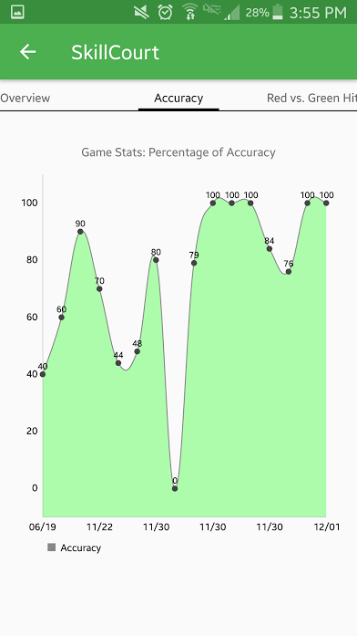
Shortcomings
Things we planned to do, but did not have time to complete
‘Speed of Play’
Statistics screen/graph

Slide 4
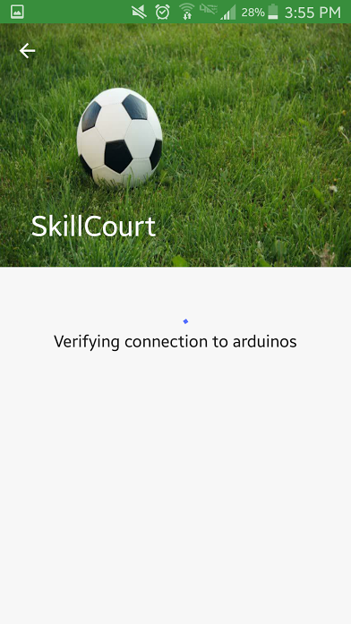
Shortcomings
Things we planned to do, but did not have time to complete
Dynamically find Arduinos

Slide 5

Shortcomings
Things we planned to do, but did not have time to complete
Tutorial/User walk-thru available

Slide 6
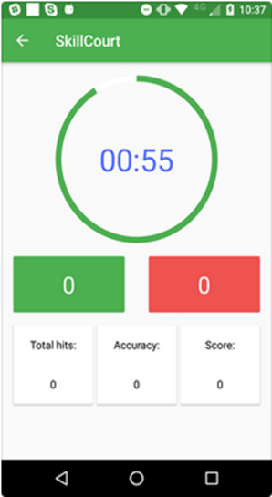
Wish List
Pause Button
Restart Button

Slide 7


Wish List
Dynamically configure Arduinos (for WiFi)

Slide 8
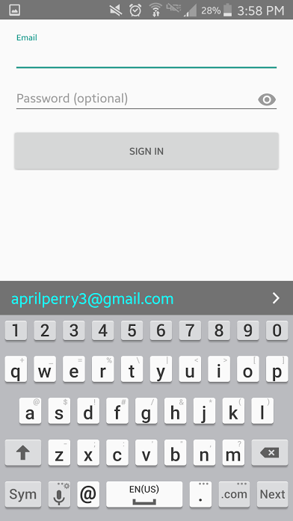
Wish List
Username attribute
To enhance player/coach searching ability
User profile
Ability to change profile settings
Profile screen accessible via the Menu
Forget Password option on Login screen

Slide 9
Thanks for watching!

